Slide 1
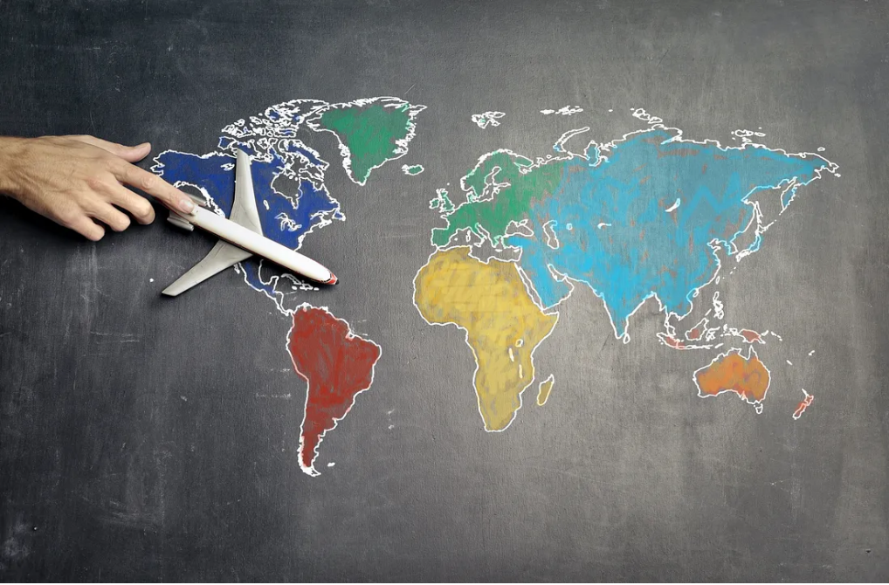
Airlines Twitter Sentiment Analysis
Course Code: DSCI 784
Course Title: Project capstone
Submitted to: Thomas Tiahrt
Submitted by: Shareef Shaik
Date of Submission: 11/30/2023

Slide 2
Introduction & Objectives
This analysis is about airline-related tweets to unveil customer sentiments.
This project employs advanced text analysis to classify emotions, identify reasons for negativity, assess sentiment confidence, and explore links between performance and user demographics.
The primary objective of our project is to delve into the sentiments expressed by consumers on Twitter regarding their experiences with different airlines.
By understanding the sentiments expressed, we aim to provide airlines with a better understanding of customer feedback and potential areas for improvement.

Slide 3
Data Source and Corpus:
The dataset is sourced from Kaggle, The dataset comprises key attributes such as 'airline_sentiment,' 'negativereason,' 'text,' 'tweet_created,' 'tweet_location,' and 'user_timezone.’
Frequency Counts:
a. Rows (Records or Tweets): 14,641
b. Columns (Variables or Attributes): 17
https://www.kaggle.com/datasets/thedevastator/sentiment-analysis-of-us-airline-twitter-data/

Slide 4

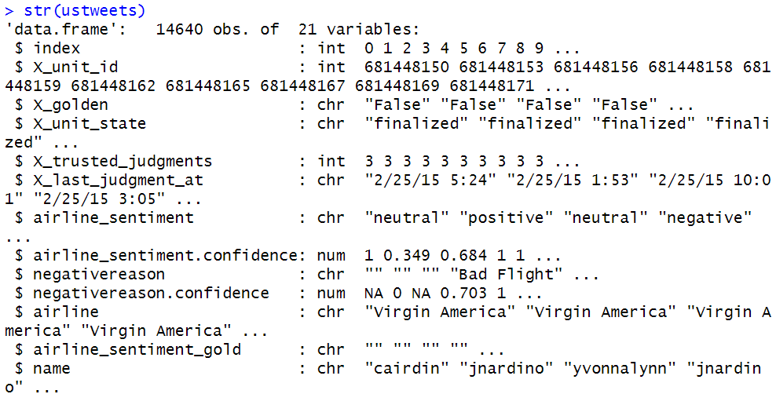
Data processing
Randomized data for unbiased analysis
Extracted relevant features: airline, sentiment, reason, text
Checked for missing values - no missing data
Plotted airlines mentions and negative reasons
Cleaning
  Lowercased
  Removed punctuation
  Removed numbers
  Removed stop words
  Stripped whitespace
  Stemmed words

Slide 5
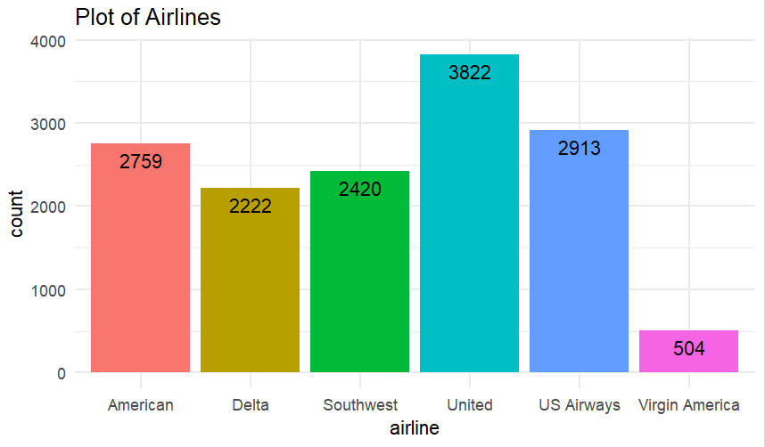
Exploratory Analysis
Plots of Airlines
Sentiment distribution
Negative reason frequency
The Plot shows that United Airlines has
Most Tweets 3822. And Virgin Airlines
Has the least 504.

Slide 6
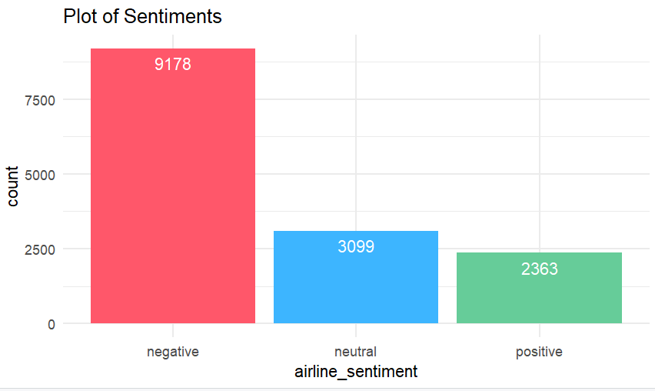
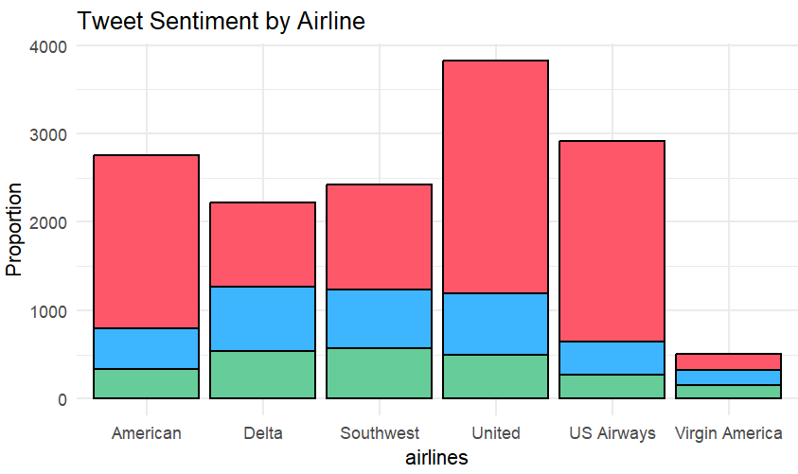
Negative Reason Frequency
The Dataset has more negative tweets, United Airlines has more negative tweets among all the airlines.

Slide 7
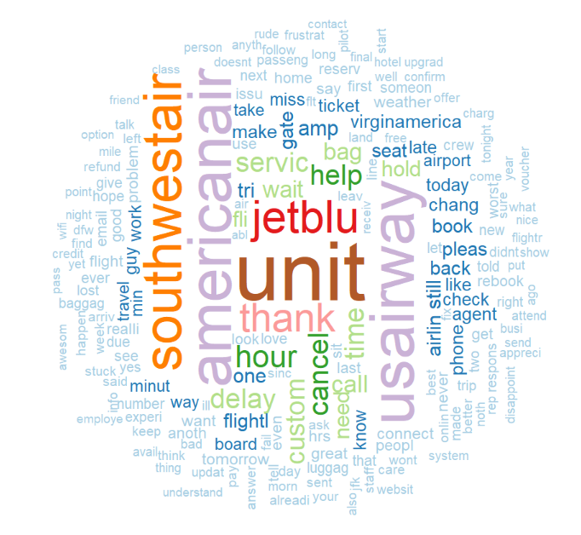
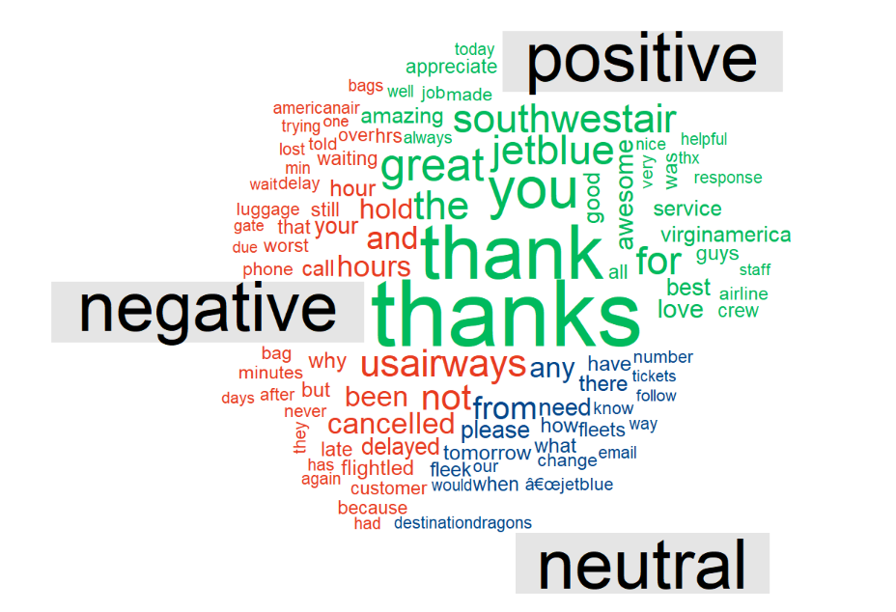
Word Cloud
Most tweets about the four airlines. And I also mentioned the delay, hour, cancel, time, help, custom and service above. These words imply that the reviews about the airlines are not good.

Slide 8
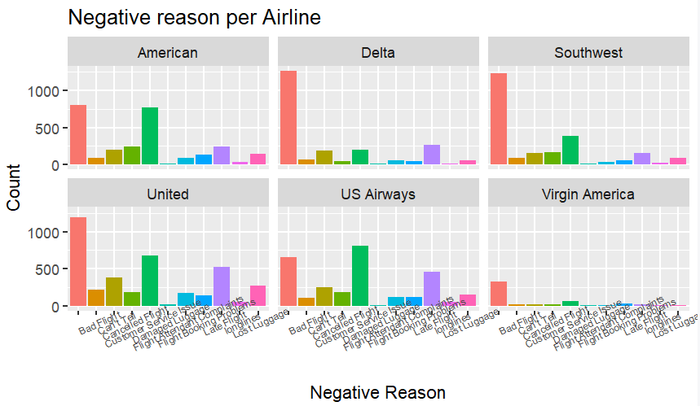
Analysis Results
United Airlines is the most tweeted and has the most negative feedback
Overall 60% of negative tweets
Negative tweets are longer
Key issues are delays, customer service

Slide 9
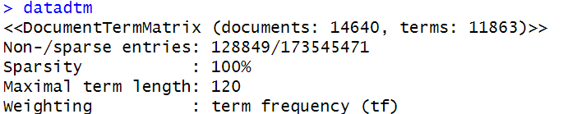
Sentiment Prediction
Compared models:
Random forest model
Logistic regression model
Logistic regression had best accuracy at 76% Used for final sentiment classification

Slide 10
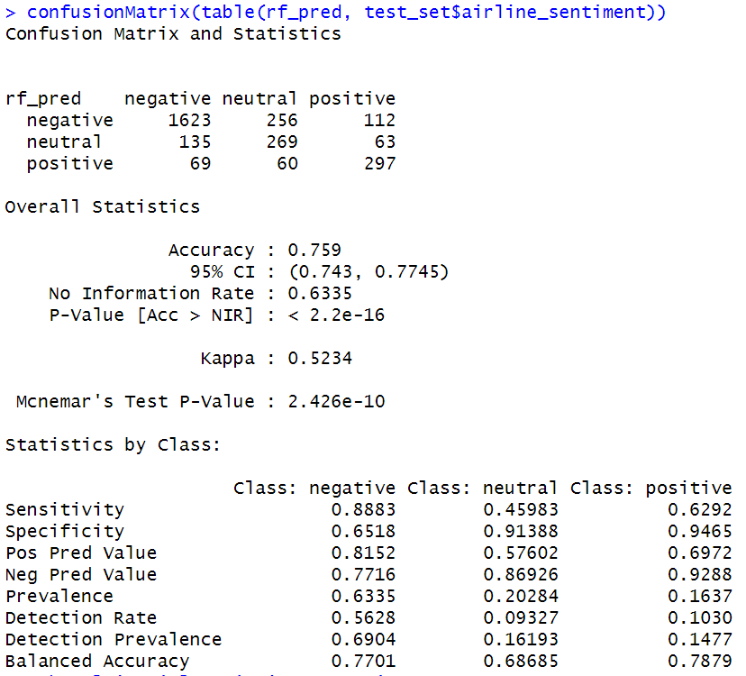
Random Forest
Accuracy: 75.9%
Balanced Accuracy: Neg: 77.01%, Neu: 68.68%, Pos: 78.79%
Kappa: 0.5234
Precision (PPV): Neg: 81.52%, Neu: 57.60%, Pos: 69.72%
Sensitivity (Recall): Neg: 88.83%, Neu: 45.98%, Pos: 62.92%
Specificity: Neg: 65.18%, Neu: 91.39%, Pos: 94.65%
NPV: Neg: 77.16%, Neu: 86.93%, Pos: 92.88%
Prevalence: Neg: 63.35%, Neu: 20.28%, Pos: 16.37%
McNemar's p-value: 2.426e-10

Slide 11
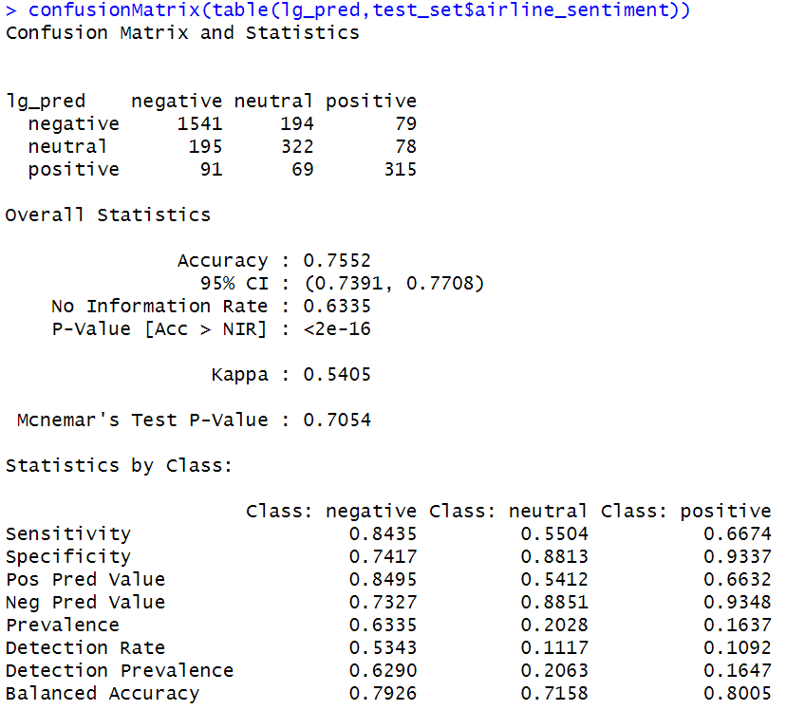
Logistic Regression
Overall Accuracy: 75.52%
Balanced Accuracy: Neg: 79.26%, Neu: 71.58%, Pos: 80.05%
Kappa: 0.5405
Precision (PPV): Neg: 84.95%, Neu: 54.12%, Pos: 66.32%
Sensitivity (Recall): Neg: 84.35%, Neu: 55.04%, Pos: 66.74%
Specificity: Neg: 74.17%, Neu: 88.13%, Pos: 93.37%
NPV: Neg: 73.27%, Neu: 88.51%, Pos: 93.48%
Prevalence: Neg: 63.35%, Neu: 20.28%, Pos: 16.37%
McNemar's p-value: 0.7054

Slide 12
Conclusion
Multinomial Logistic Regression outperformed Random Forest and achieved the highest accuracy.
Multinomial Logistic Regression performed well in classifying neutral and positive outcomes.
The dataset showed 26% of tweets about United Airlines, most complaining about bad service and late flights.
Multinomial Logistic Regression was identified as the best model for sentiment prediction with 76% accuracy.

